Slide 1
TRAINING AND PLACEMENT SYSTEM

Slide 2
GROUP DETAILS
S.NO | ROLL NO. | NAME | ROLE
1 | CB.EN.U4CSE20231 | KISHORE A V | Leader
2 | CB.EN.U4CSE20243 | NAVEEN S S | Developer
3 | CB.EN.U4CSE20246 | PRANAV A S | Designer
4 | CB.EN.U4CSE20252 | SAI RAMYA ILLURI | Testing and Documenting

Slide 3
ABSTRACT
>>Introduction:
This courses portal is based on database management system which is to be used by training and placement department, this project will contain the all the aspects of training and placement department like managing meetings, student data, placement details, company details, etc. The system is an online application that can be accessed throughout the organization and outside as well with proper login provided. This system can be used as an application for the Administrator of the college to manage the student information with regards to placement.

Slide 4
>>Functionalities of the system:
Students:
Students who are all willing to attend the placement can register through this system using their own college mail-id. After successful registration and log in they can see the details of the companies visiting the campus such as placement date, company name, year of establishment, address, eligibility criteria for the students they are seeking. Students can also update their personal information.
Administrator:
The administrator can add or delete or update the details of companies and students registered. After successful registration of students, he will update the details of students such as aggregate marks, their skill set, their technical skills, etc.

Slide 5
Faculty:
Faculties can also register as faculty using their own college mail id in this application. After successful log in faculty can see the details of the students who had got placed in the company visit to the campus, student and company details and internship details such as internship period, deposit for internship, etc. Faculties can also create report based on their requirements.
>>Benefits of the system:
Track campus placement status.
The application automatically notifies about upcoming placements.
This system helps to see the details of placed students.
Store all data forever.

Slide 6
.
>>Modules in the system:
This system includes the following modules,
Interface creation for online training and placement system.
Students, faculty and administrator (Register/Login) Module.
Maintaining training records of students and their personal information.
Maintaining the records of Company details.
Maintaining the details of the students who got the placement.
Report of students got placed, rejected and interns for faculty.
>>Development Platform:
For Database - SQL
For User Interface - Java

Slide 7
WHAT IS A SCHEMA DIAGRAM?
A database schema is the skeleton structure that represents the logical view of the entire database. It defines how the data is organized and how the relations among them are associated. It formulates all the constraints that are to be applied on the data.
A database schema defines its entities and the relationship among them. It contains a descriptive detail of the database, which can be depicted by means of schema diagrams. It’s the database designers who design the schema to help programmers understand the database and make it useful.

Slide 8
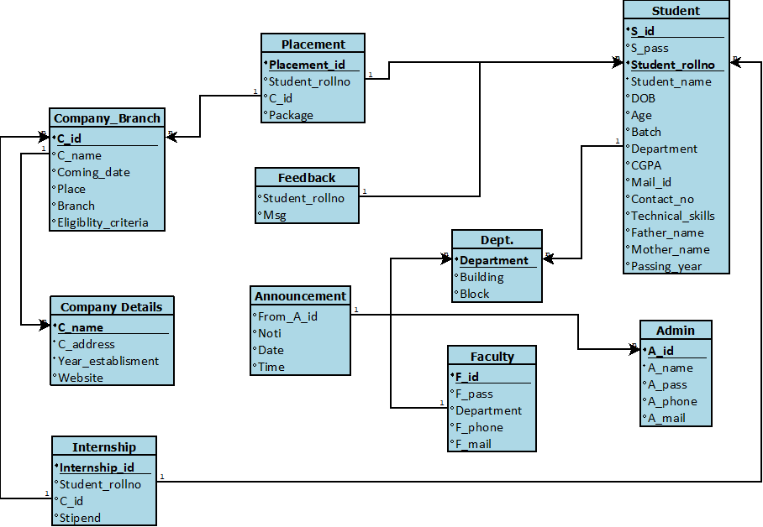
SCHEMA DIAGRAM

Slide 9
WHAT IS AN ER MODEL ?
ER model stands for an Entity-Relationship model. It is a high-level data model. This model is used to define the data elements and relationship for a specified system.
It develops a conceptual design for the database. It also develops a very simple and easy to design view of data.
In ER modeling, the database structure is portrayed as a diagram called an entity-relationship diagram.
For example, Suppose we design a school database. In this database, the student will be an entity with attributes like address, name, id, age, etc. The address can be another entity with attributes like city, street name, pin code, etc and there will be a relationship between them.

Slide 10
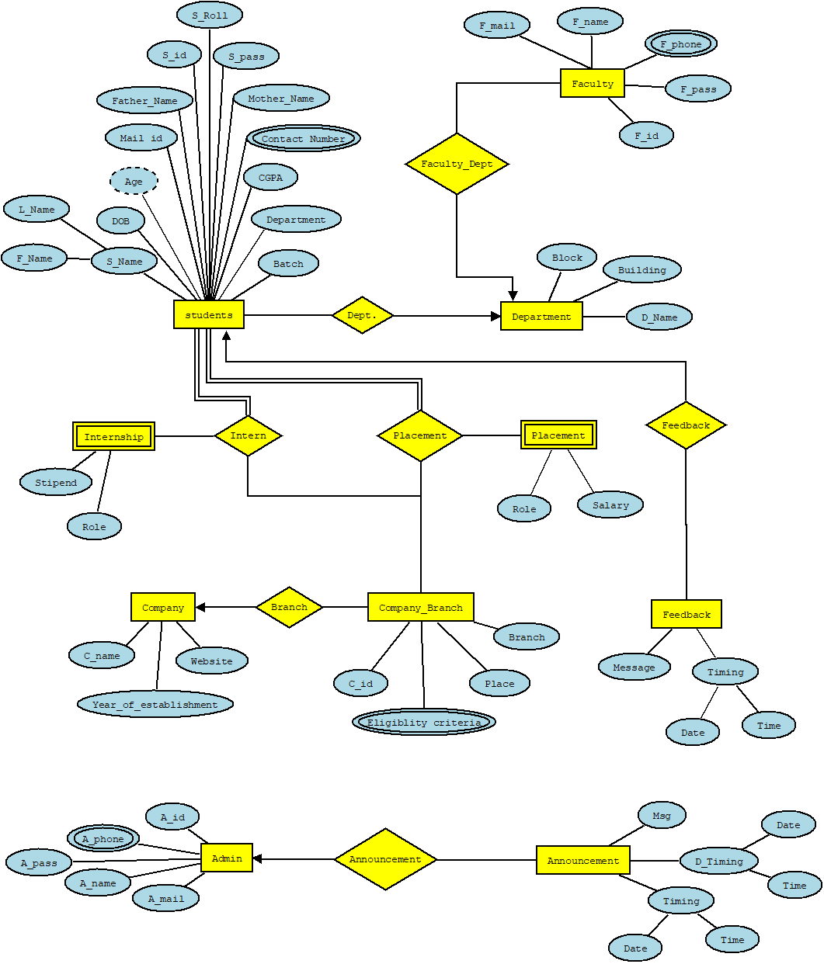
ER DIAGRAM

Slide 11
THANK YOU

